Slide 1

Searching for Brown Dwarfs in the JWST North Ecliptic Pole Time-Domain Field
Thomas Tyburczy
Advisor: Dr. Rolf Jansen
School of Earth and Space Exploration
Arizona Space Grant Statewide Symposium
Saturday April 13, 2019

Slide 2
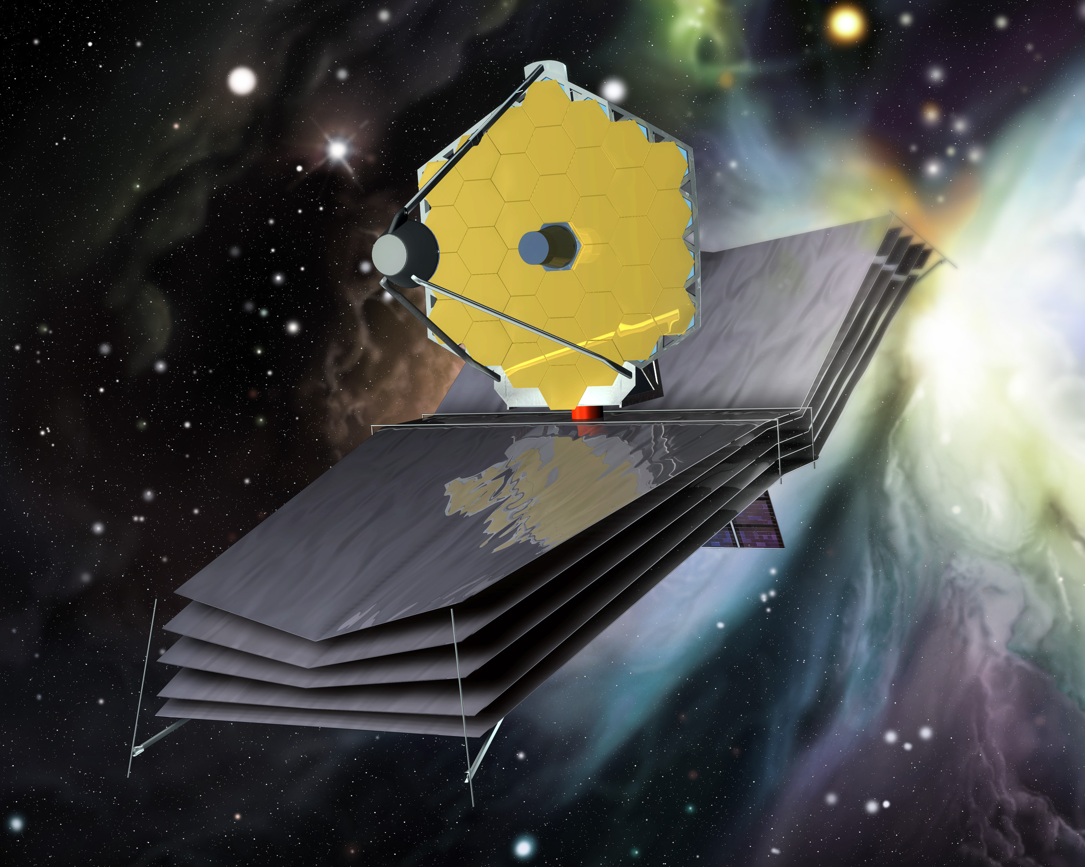
JWST NEP TDF
Lets unpack this
  JWST – James Webb Space Telescope
  NEP – North Ecliptic Pole
  TDF – Time-Domain Field
(Source: STScI)

Slide 3
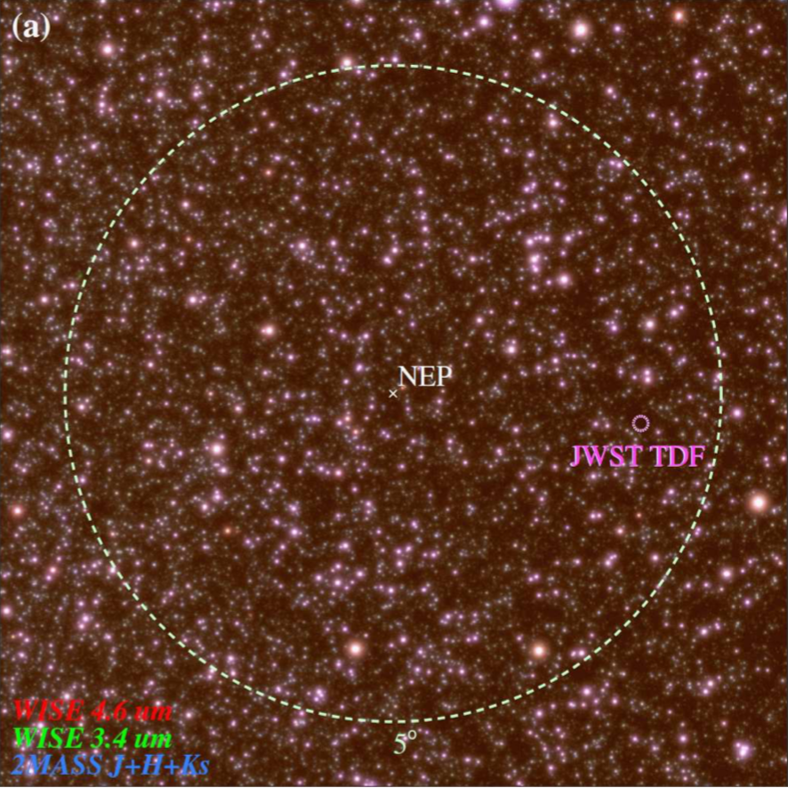
Why Brown Dwarfs (Justification)
Uses of the JWST NEP TDF
  Variability of Active Galactic Nuclei (AGN)
  Characterizing of brown dwarf atmospheres
  High redshift transient searches and monitoring
    (e.g. supernovae, galactic brown dwarfs)
  Study white dwarfs
  Potential for observing scattered Kuiper Belt and Oort Cloud objects
Goals:
  Identify targets to for JWST once it launches in 2021
(Source: Jansen & Windhorst 2018)
Notes:
-Figure shown is a color composite of WISE 4.6um (r), WISE 3.4um (g), and 2MASS J+H+K_S (b).
-Outer Ring is 5 degrees in diameter and represents the CVZ of the

Slide 4
Methods
Data used:
  3 GHz VLA image (1 σ rms of 0.9 μJy)
    Observation Date: November 29, 2017
  Color composite of LBT g (464 nm), r (568 nm), and z (900 nm) bands
Focused on:
  Point-sources
  Visible in radio image
  In color composite, brightest in the z band (redder)
Notes:
-LBT is located on Mt. Graham in Arizona. Selected sources based on

Slide 5
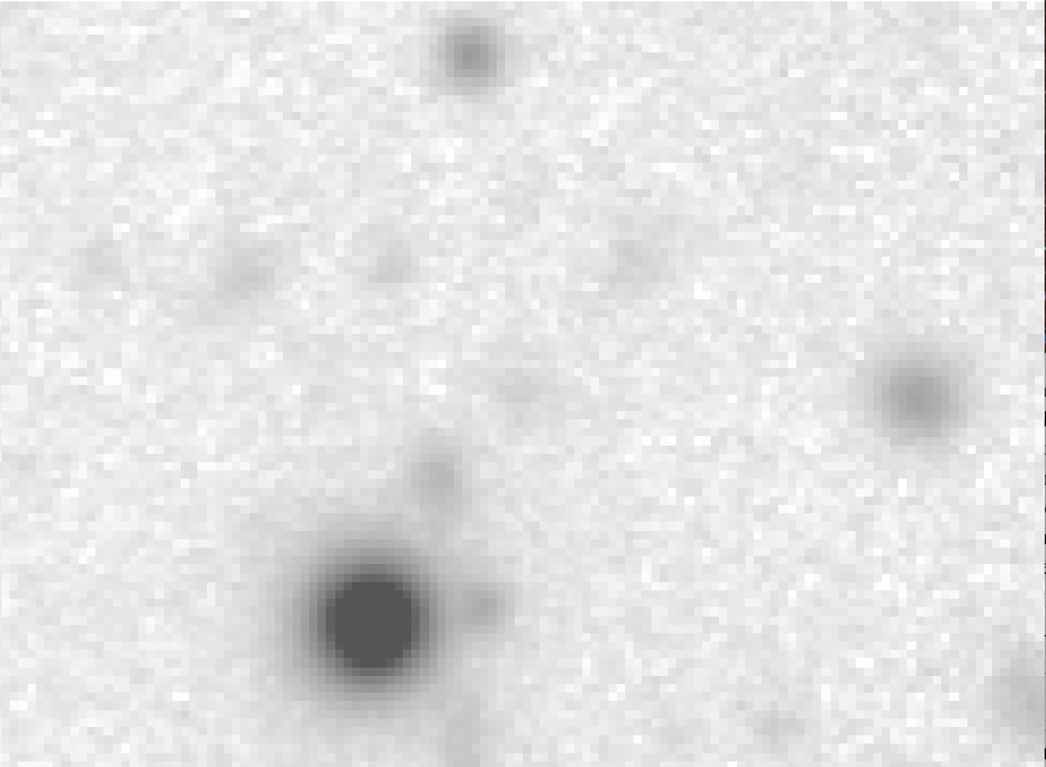
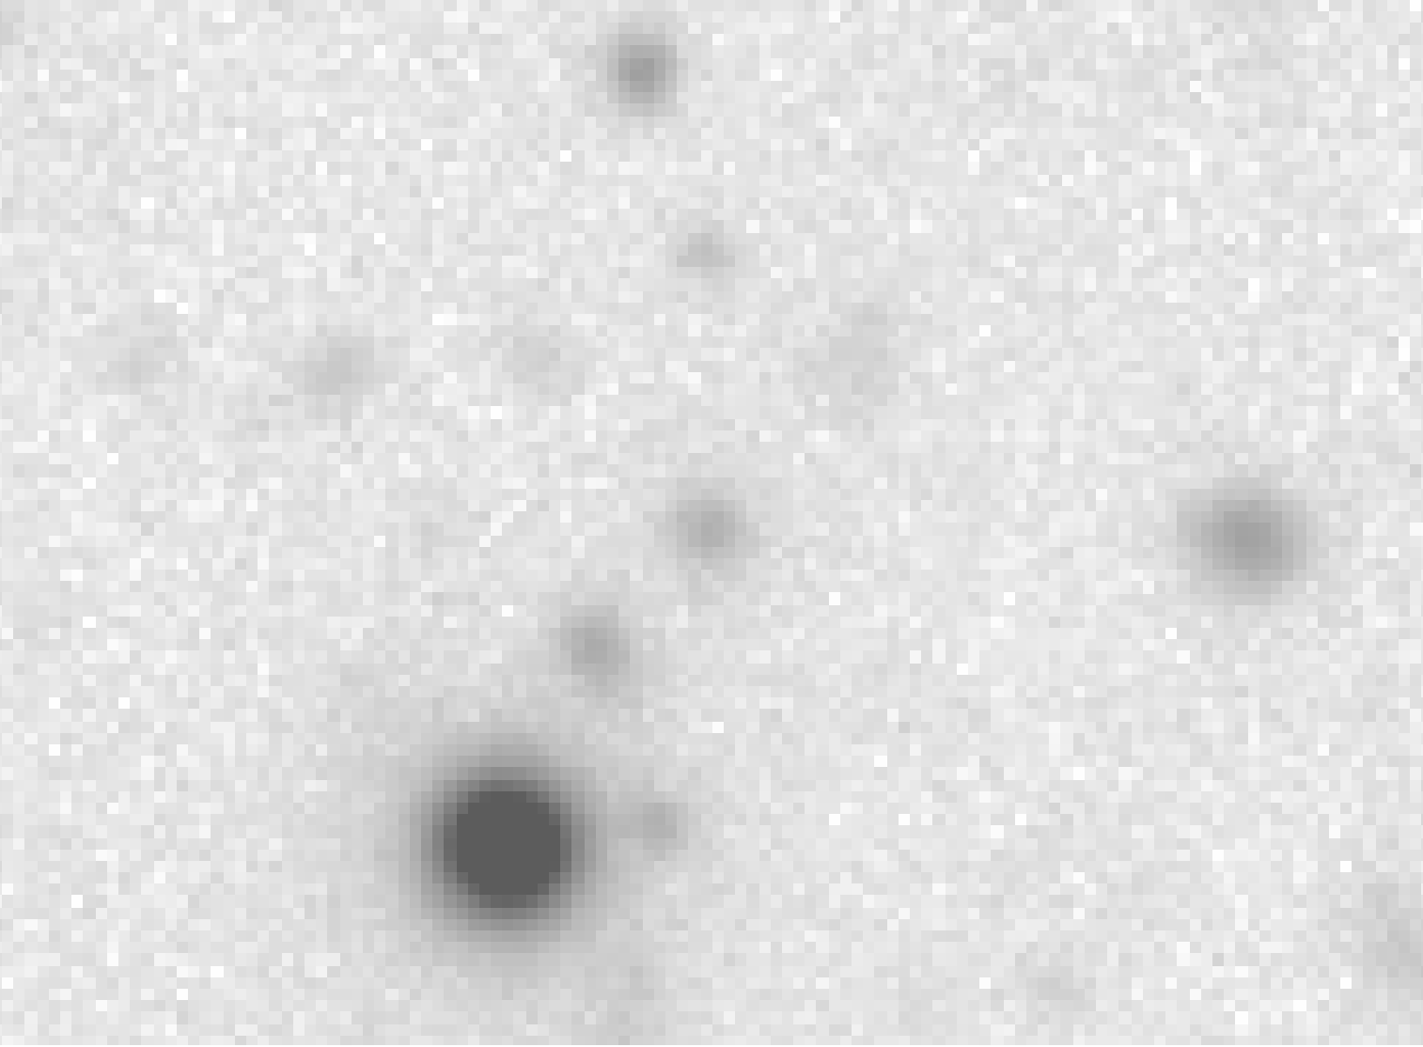
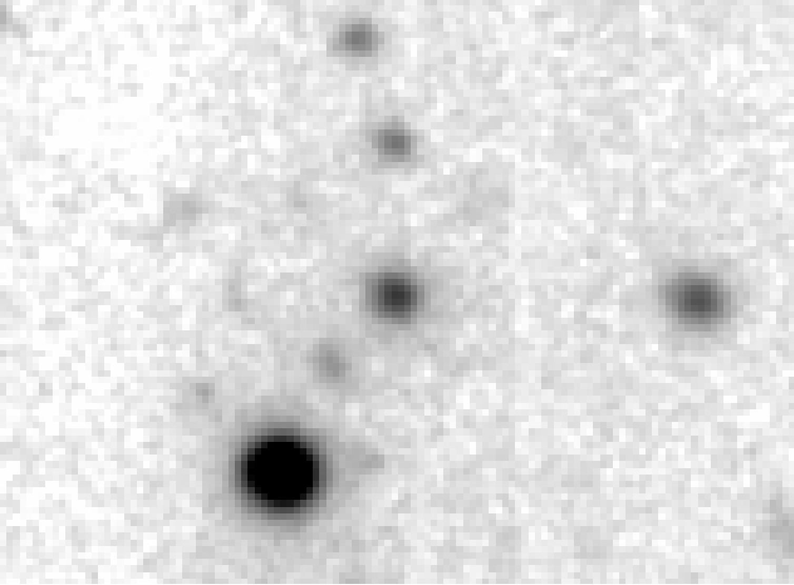
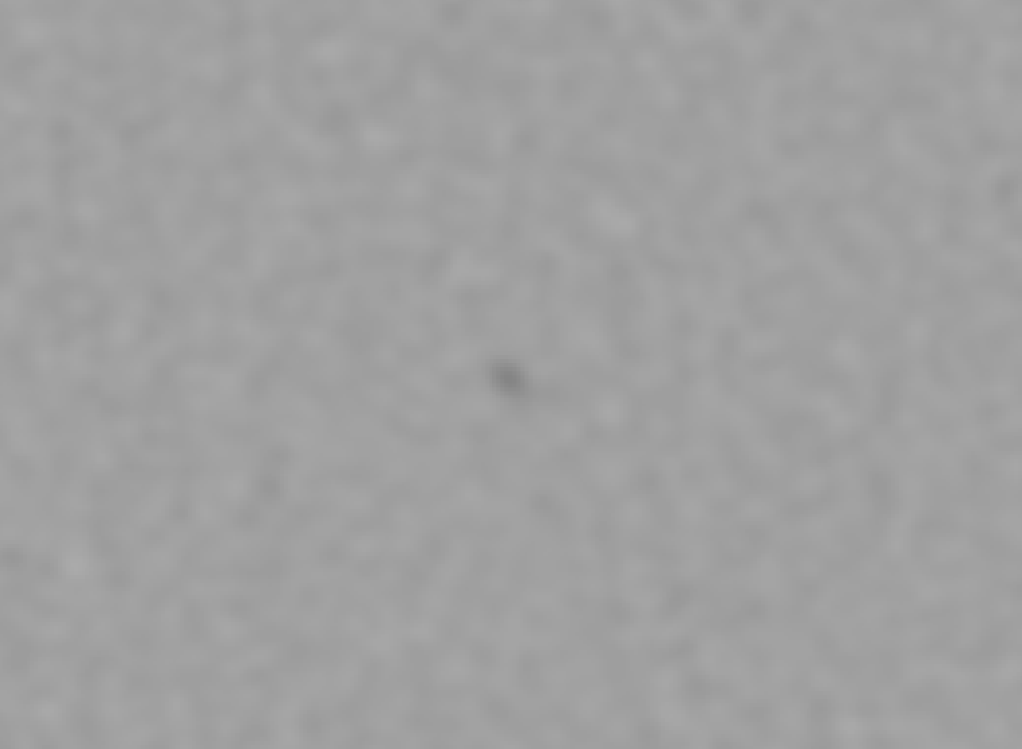
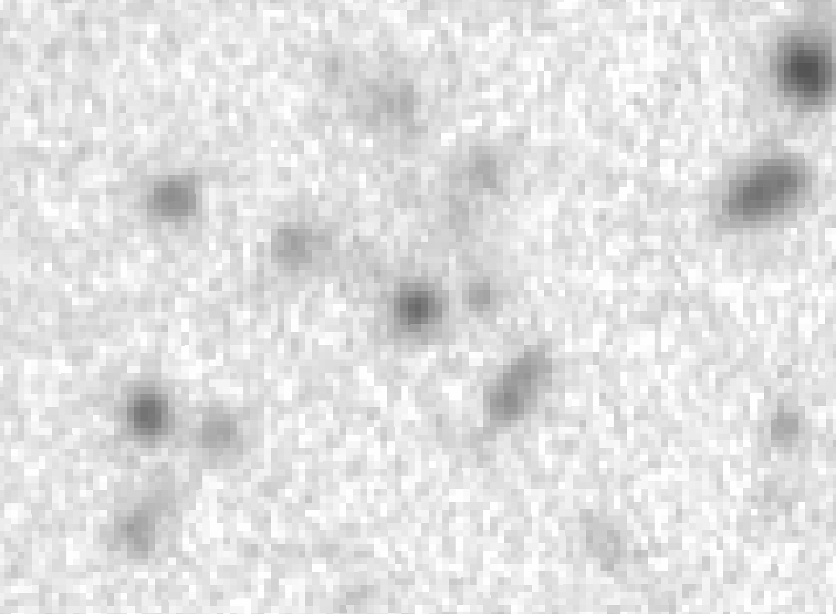
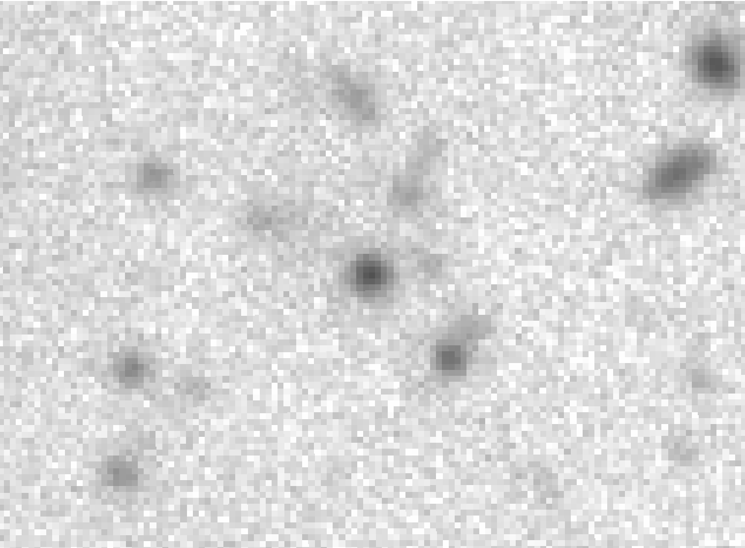
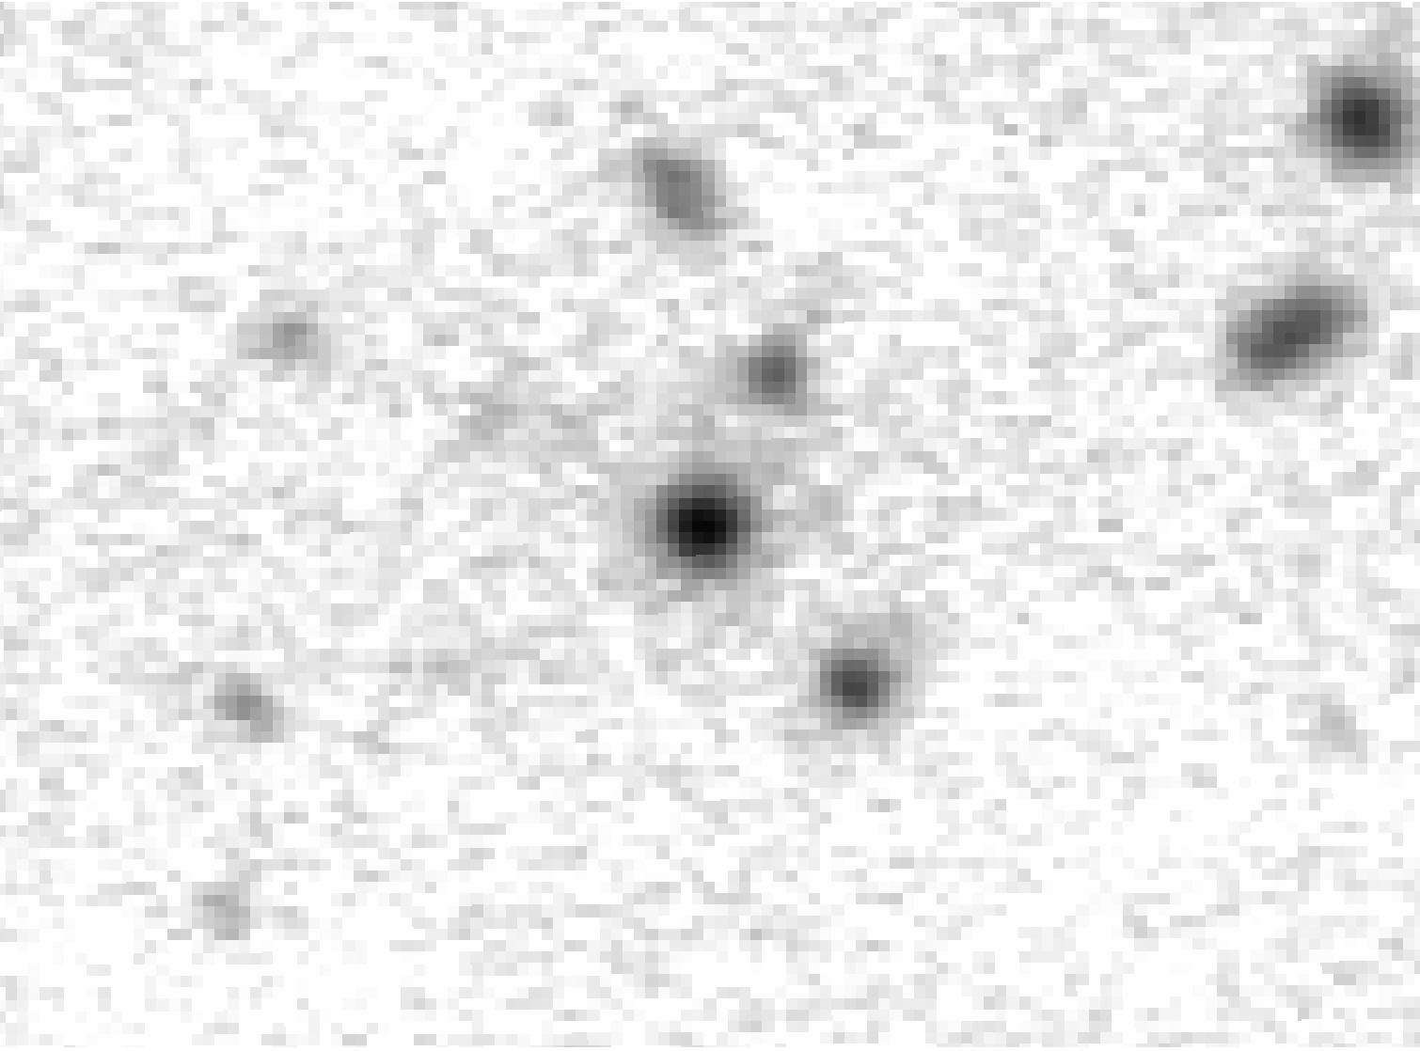

Selected Objects; Potential Brown Dwarfs
LBT g band
LBT r band
LBT z band
VLA 3 GHz
Here each row is a separate source. All images are 0.33’ x 0.45’

Slide 6
Selected Objects; Potential Brown Dwarfs
LBT g band
LBT r band
LBT z band
VLA 3 GHz
Here each row is a separate source. All images are 0.33’ x 0.45’

Slide 7
Results
This selection yielded 216 candidates from the roughly 456 square arcminutes of shared coverage from the images
Catalogue matching with VLA, and LBT g,r source catalogs
  Now N = 111
    The difference between these counts is likely due to the inability of the automated cataloging process to identify very faint objects in

Slide 8
Results
This selection yielded 216 candidates from the roughly 456 square arcminutes of shared coverage from the images
Catalogue matching with VLA, and LBT g,r source catalogs
  Now N = 111
    The difference between these counts is likely due to the inability of the automated cataloging process to identify very faint objects in LBT g, r images
LBT g band
LBT r band
LBT z band
VLA 3 GHz

Slide 9
Next Steps
Use MMT/MMIRS YJHK near-IR data to validate candidates found
  Focuses on the peak wavelength of Brown dwarfs
Perform stacking analysis on sources that are not matched with catalogues
  Helps improve signals
Obtain other epochs of VLA and LBT data to compare for further time-domain analysis
Notes:
-MMT = Multiple Meter Telescope, on Mt. Hopkins in Arizona
-Y = 1020 nm, J = 1220 nm, H = 1630 nm, K = 2190nm

Slide 10
Summary
Identification of brown dwarfs in the JWST NEP TDF helps us perform time-domain science in two ways
  They can be removed from variable AGN candidate pools
  Their atmospheres can be studied
Studying of variable AGN helps us understand black holes, galaxy evolution, and cosmology
Studying the atmospheres of brown dwarfs gives us an idea about their ‘weather’ and whether or not life-sustaining planets may have formed around them
Thank you!
tom.tyburczy@asu.edu

